Slide 1

Leadership Strategies
Assignment 1
Influence Vs. Power
Submitted to Miss Maryam Farooq
Submitted by Hamza Farooq (2016-CS-122)

Slide 2
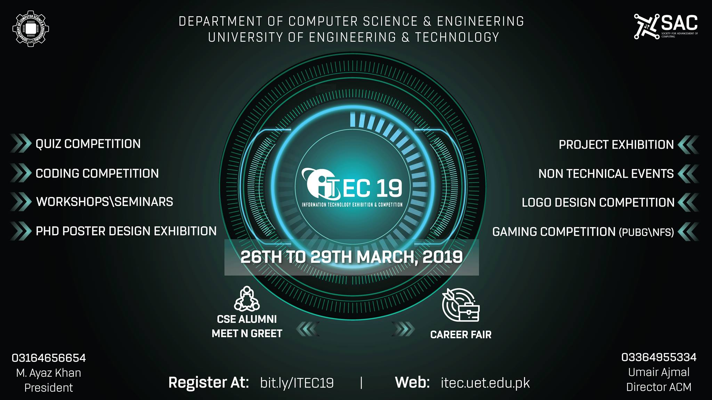
Q1. Write down one event…
about that?
I volunteered in ITEC 19 organized by Society of Advancement of Computing, Computer Science department.
I was in the team of tech-heads and our goal was to setup Lab computers for coding competition. We had to lead the group members in installing essential software.

Slide 3
Cont…
It was influence as there were many fellows who volunteered in that event. I practiced hands-on leadership tactics by setting up computers while being tech head and working with tech team members.
Overall experience was good. I got recognition and respect among juniors.

Slide 4
Cont…
I learnt about the controller software so called PC-Square.
Grasp the bullets of connecting participants to master computers centrally.
Became a competent in managing a cross-university event.

Slide 5
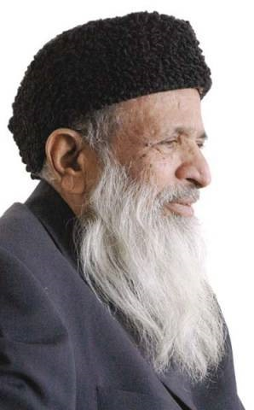
Abdul Sattar Edhi,
Q2. Think about the leaders…
perception?
A Pakistani philanthropist, ascetic, and humanitarian who founded the Edhi Foundation, which runs the world's largest volunteer ambulance network

Slide 6
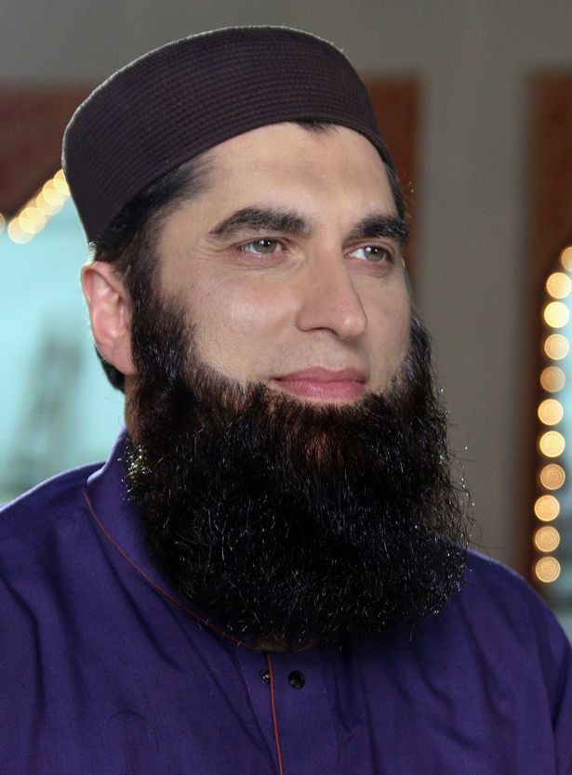
Junaid Jamshed Khan
Cont…
A Pakistani recording artist, television personality, fashion designer, occasional actor, singer-songwriter, and preacher.

Slide 7
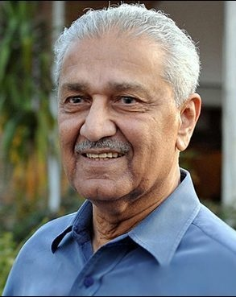
Dr. Abdul Qadeer Khan
Cont…
A Pakistani columnist, nuclear physicist and metallurgical engineer who founded the uranium enrichment program for Pakistan's atomic bomb project

Slide 8
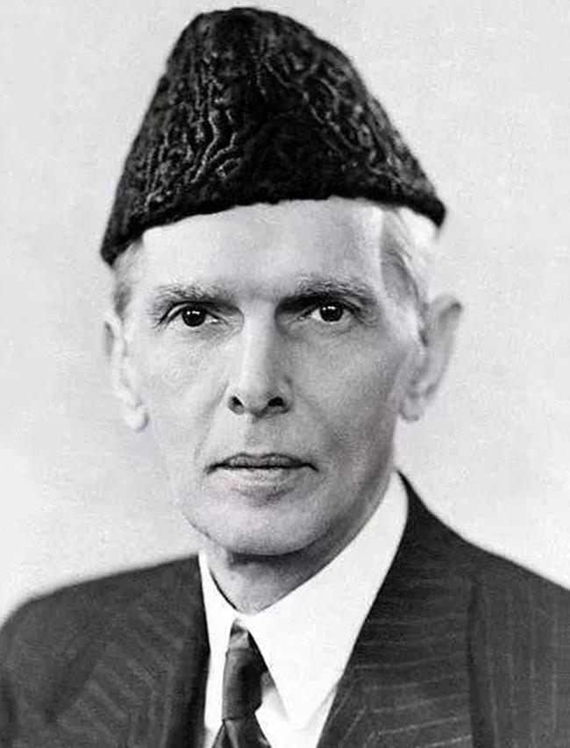
Muhammad Ali Jinnah
Cont…
Extremely intelligent lawyer, hard-working, man with vision and peace loving person. Known as Quaid-e-Azam or Great Leader. He successfully campaigned and led Pakistan’s independence from India.

Slide 9
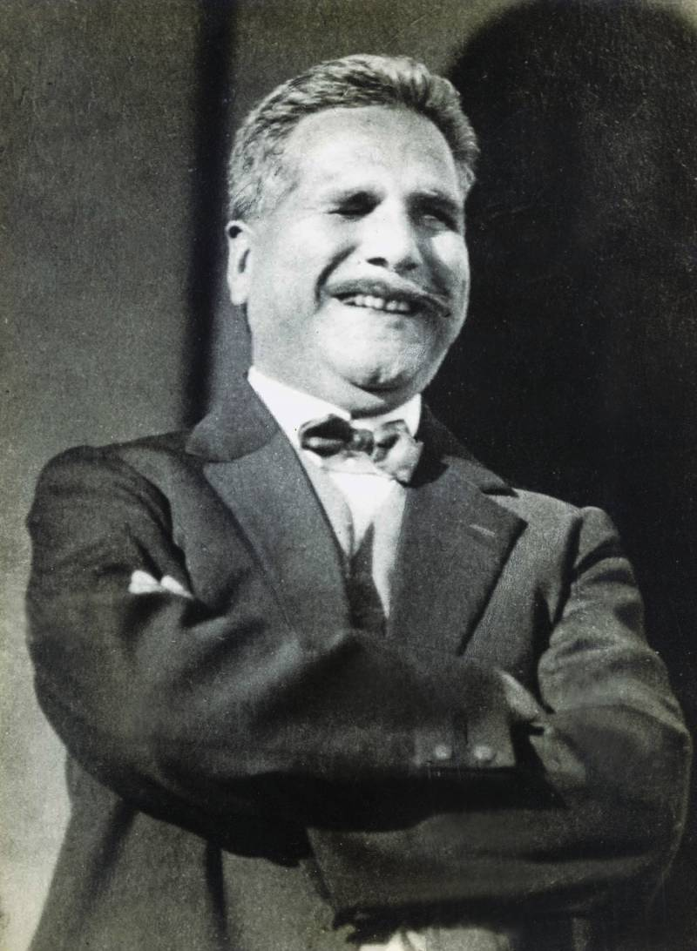
Allamah Iqbal
Cont…
Inspired the Pakistan movement by his Sufi Kalaam. He is considered one of the most important figures in Urdu literature, literary work such as Shikva and Jawab-e-Shikva.

Slide 10
Jazakallah Kher
“Power lasts ten years; influence not more than a hundred”

